Slide 1
Program
MineOperate Technical Overview
Field Hardware Overview
Edgar Sepulveda
Global Technical Manager, MineOperate
10/10/2022
Version 1.3

Slide 2

Purpose
This session shows MineOperate hardware, external sensors and antennas and details some hardware configurations.
At the end of this module, you will:
know current and legacy MineOperate hardware​.
know current external sensors and antennas.
check some hardware configurations.

Slide 3
MineOperate Field Hardware
Current MineOperate Hardware
Core Hub
JPS
Display 12
Display 9
Legacy MineOperate Hardware
UHP Hub
Jasset
Mojo7
MCS
JS Comms LP Hub
JS Comms HP Hub
12” Planar Screen
8.4” Planar Screen
DSE Screen

Slide 4
MineOperate Field Hardware
Current External Sensors
Encoder
Angle Sensor
Pressure Sensors
Air Switch
Antennas
Mobilemark Wi-Fi
RFI Wi-Fi
G3 GNSS
G5 GNSS
Mini G3 GNSS
Tallysman GNSS
Cellular

Slide 5
MineOperate Field Hardware
Example System Configurations
LP Truck Core HW
HP Dozer Core HW
HP Drill Core HW
HP Shovel / Excavator Core HW
LP Truck UHP HW
HP Dozer UHP HW
HP Drill UHP HW
HP Shovel / Excavator UHP HW
Jasset system
Mojo7
Installation Hardware
Install Kits

Slide 6
Current MineOperate Hardware

Slide 7
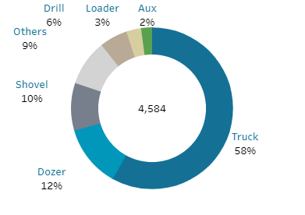
Active MineOperate Hardware
Hexagon - Dashboard - MineOperate Install Base (hexagonmining.com)
August 2022
Active Units
Types of Units
Notes:
Over 4,000 active OP pro units in the world. The majority of them are Low precision.
More than half of our units are trucks (58%). The next largest is dozers, followed by shovel. ‘Others’ we aren’t sure of.

Slide 8
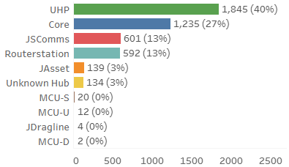
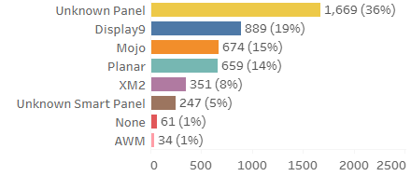
Active MineOperate Hardware
Hexagon - Dashboard - MineOperate Install Base (hexagonmining.com)
Hubs
Panels
Notes:
40% of our active hubs are UHP. This is a legacy hardware which is being replaced with Core. Only 27% of our hubs are core, so we actually have nearly three quarters of our hubs are legacy hardware.
Panels are more difficult to identify due to configuration of the devices not being clear, which is why we have 36% unknown.

Slide 9
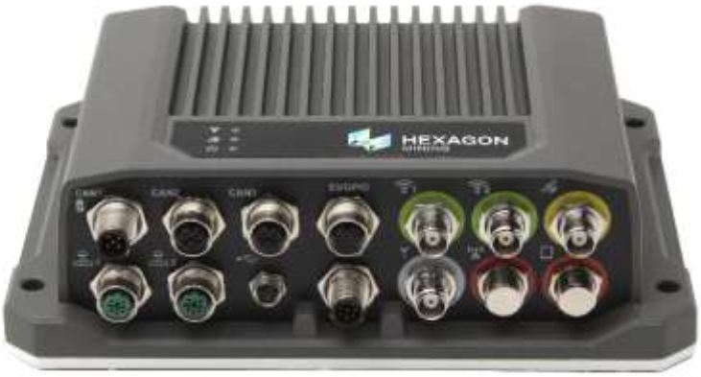
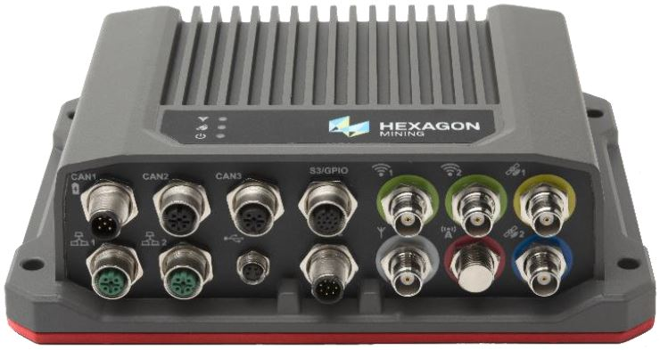
Current MineOperate Hardware
Platform | Details
Core Hub | The Core hub is a purpose designed and built unit that has both LP and HP variants with a Quad core intel 1.9Ghz CPU, dual 802.11 a/b/g/ac Wi-Fi, single (LP) or dual (HP) GNSS receivers, 2 Ethernet ports, 3 CAN ports, 2 RS232 Serial ports, 1 RS232/RS422 port, 3 Digital inputs, 1 Digital output and 1 USB port. It can also have a 4G Cellular or internal UHF radio as an option. It has a wide 9-36V DC input power range that allows it to be used without specific power supplies. It has a small physical footprint of 22.6cm x 69cm x 16.3cm and a weight of just 2.075 kg making it suitable for mounting inside the cabs of most machines and is IP67 rated with an operating temperature range of -40°C to +60°C allowing it to be outside where required. All connections use industry standard M12, M8 or TNC connectors. The LP variants are quickly identifiable by the light grey base plate while the HP variants are also easy to identify with a red base plate.

Slide 10
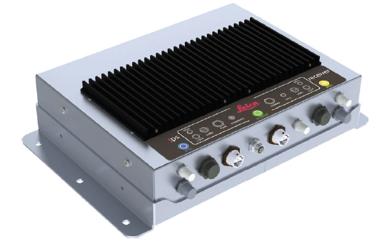
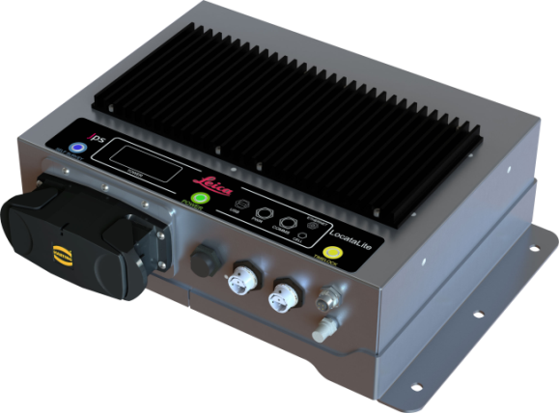
Current MineOperate Hardware
Platform | Details
JPS Module | The JPS module is a GPS augmentation system for use in deep pits where GPS coverage is an issue. It is available in a single or dual receiver version and is used in conjunction with a Core hub, UHP hub or MCS module. There is also a single receiver LocataLite module that is used to create the JPS ground based constellation. JPS uses fixed and mobile LocataLite units to create a ground based constellation that uses 2.4GHz signals to provide position information in addition to GPS.

Slide 11
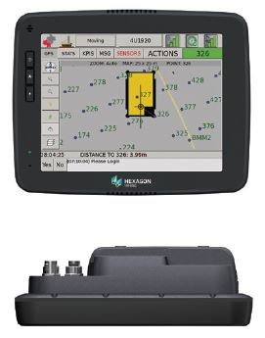
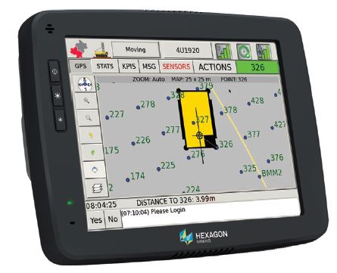
Current MineOperate Hardware
Platform | Details
Display 12 | The Display 12, sometimes referred to as the Jsmart Panel is an off the shelf display with an Intel Atom E3826 dual core CPU and an Intel HD graphics Gen 7 Graphics Processing Unit (GPU). It has an 8GB, CFast card that is accessible via a cover on the top of the screen. It has 2 Ethernet, 2 USB and one serial port with M12 connectors. There are also a number of other ports that are not used by any Hexagon Mining systems. It has an input voltage range of 10-34V DC allowing it to be connected to the same supply as the Core or UHP hub. The screen is IP 65 rated with an operating temperature range of -25°C to +70°C and has a VESA 75 footprint allowing our standard RAM mounts to be used for mounting. Typically, the Display 12 is only installed on HP drills, shovels and excavators.

Slide 12
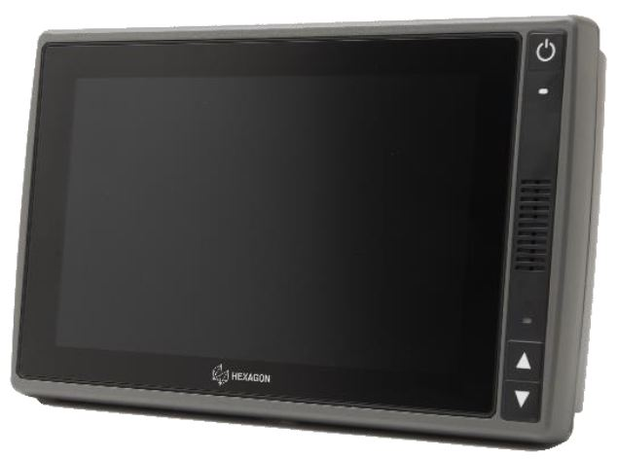
Current MineOperate Hardware
Platform | Details
Display 9 | The Display 9 is an off the shelf display with an Intel Atom E3826 dual core CPU and an Intel HD graphics Gen 7 Graphics Processing Unit (GPU). It has an 8GB, CFast card that is accessible via a cover on the top of the screen. It has 2 Ethernet, 2 USB ports with M12 connectors. It has an input voltage range of 10-34V DC allowing it to be connected to the same supply as the Core or UHP hub. The screen is IP 65 rated with an operating temperature range of -25°C to +70°C and has a VESA 75 footprint allowing our standard RAM mounts to be used for mounting. It has a capacitive touch screen that is more responsive and less prone to damage that the resistive touch screen of the Display 12. Typically, the Display 9 is installed on HP dozers and all LP equipment.

Slide 13
Legacy MineOperate Hardware

Slide 14
Current MineOperate Hardware
Platform | Details
UHP Hub | The UHP hub is a purpose designed and built unit that has both LP and HP variants with a Dual core 733 Mhz CPU, VGA Display with USB, 802.11 b/g/n Wi-Fi, single (LP) or dual (HP) GNSS receivers, 3 Ethernet ports, 2 CAN ports, 3 RS232 Serial ports, 2 RS232/RS422/RS485 ports, 5 Digital inputs, 2 Digital outputs and 1 USB port. It has a wide 9-36V DC input power range that allows it to be used without specific power supplies. It has a physical footprint of 32.3cm x 22.8cm x 9.9cm and a weight of 3.811 kg making mounting inside the cabs of some machines difficult. It is IP67 rated with an operating temperature range of -40°C to +60°C allowing it to be outside where required. It uses a variety of military, M12, TNC and N connectors. The LP variants are quickly identifiable by the light grey color while the HP variants are also easy to identify with a red color. Production of the UHP has ceased and end of life was announced in 2019 with repairs to be continued until December of 2022 or until parts are no longer available. The UHP has been replaced by the Core hub.

Slide 15
Current MineOperate Hardware
Platform | Details
Jasset Module | The Jasset module is a purpose designed and built unit that has variants with W-Fi, 4G Cellular or both for communications. It has a 400Mhz CPU, 1 802.11 b/g/n Wi-Fi, 4G Cellular, 1 GNSS receiver, 1 Ethernet port, 2 RS232 ports, 2 CAN ports, 2 Digital inputs, 1 Digital output and 1 USB port. It has a wide 9-36V DC input power range that allows it to be used without specific power supplies. It was designed as a low cost unit for mobile asset tracking or the 4G variant could be used in conjunction with a UHP for sites that want cellular communications. Production of the Jasset module has ceased and end of life was announced in 2019 with repairs to be continued until December of 2022 or until parts are no longer available.

Slide 16
Current MineOperate Hardware
Platform | Details
Mojo7 | The Mojo7 is purpose designed and built all-in-one computer and display with a resistive touch screen. It has GPS, 1 Ethernet port, 2 RS232 ports, 2 CAN ports, 1 Digital input, 1 Digital output and 1 USB port. It has a wide 9-36V DC input power range that allows it to be used without specific power supplies. It was designed as a low cost fleet monitoring product with connection to external communications devices. It has been paired with the Jasset module to provide Wi-Fi or Cellular communications. Production of the Mojo7 has ceased and end of life was announced in 2019 with repairs to be continued until December of 2022 or until parts are no longer available.

Slide 17
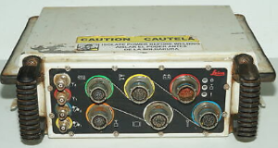
Obsolete MineOperate Hardware
Platform | Details
MCS Module | The MCS module was a purpose designed and built unit with a 733Mhz CPU, a single 802.11 b/g Wi-Fi, single or dual GNSS receivers, 1 Ethernet port, 1 CAN port, 3 RS232 Serial ports, 1 RS232/RS422/RS485 port, 5 Digital inputs, 2 Digital outputs, Quadrature encoder port and LVDS display connection. It was designed for HP systems with the single GNSS version for use on dozers and the dual GNSS version for use on drills, shovels and excavators. Production of the MCS has ceased and end of life was announced in 2016 with repairs to be continued until December of 2018 or until parts are no longer available. The MCS was replaced by the UHP hub.

Slide 18
Obsolete MineOperate Hardware
Platform | Details
JS Comms LP Module | The JS Comms LP hub was a purpose designed and built unit with a 733Mhz CPU, single 802.11 b/g Wi-Fi, 1 Ethernet port, 1 RS232 port, 2 RS232/422/485 ports, 1 digital input, 1 USB port and VGA display connection. GPS was available via the use of an external GPS receiver with a serial connection to the hub. It was designed for use in low precision (LP) fleet management solutions and was originally used with a Xenarc screen, but this was later replaced with the 8.4” Planar screen. Production of the JS Comms LP hub has ceased, and end of life was announced in 2016 with repairs to be continued until December of 2018 or until parts are no longer available. The JS Comms LP hub was replaced by the UHP LP hub.

Slide 19
Obsolete MineOperate Hardware
Platform | Details
JS Comms HP Module | The JS Comms HP hub was a purpose designed and built unit that had dual GNSS receivers, a quadrature encoder port and USB port. It was designed to be connected to a JS Comms LP hub to provide a high precision (HP) functionality for dozers, shovel and excavators. Production of the JS Comms HP hub has ceased, and end of life was announced in 2016 with repairs to be continued until December of 2018 or until parts are no longer available. The JS Comms HP hub was replaced by the UHP HP hub

Slide 20
Obsolete MineOperate Hardware
Platform | Details
12” Planar Screen | The 12” Planar screen is an off the shelf VGA display with an infra red touch screen and internal buzzer. It is used with the UHP hubs and JS Comms LP hubs. It is powered from the hub it is connected to via a single screen cable. It has one large circular connector on the rear and brightness controls on the front of the screen This was the standard display used with all HP systems until the introduction of the Display 12. Whilst we still have stock of this display the supplier is no longer manufacturing the display and end of life was announced in 2016 with repairs to be continued until December of 2018 or until parts are no longer available. The 12” Planar screen was replaced by the Display 12.

Slide 21
Current MineOperate Hardware
Platform | Details
8.4” Planar Screen | The 8.4” Planar screen is an off the shelf VGA display with an infra red touch screen and internal speaker. It is used with the UHP hubs and JS Comms LP hubs. It is powered from the hub it is connected to via a single screen cable. It has one large circular connector on the rear and brightness controls on the front of the screen. This was the standard display used with all LP systems until the introduction of the Display 9. Whilst we still have stock of this display the supplier is no longer manufacturing the display and end of life was announced in 2019 with repairs to be continued until December of 2022 or until parts are no longer available.

Slide 22
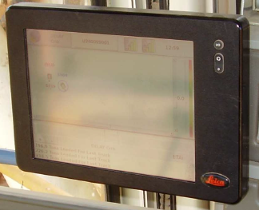
Obsolete MineOperate Hardware
Platform | Details
DSE Screen | The DSE screen is an off the shelf LVDS display with a resistive touch screen. It is used with the MCS module and was available in a 8” and 10” version. It is powered from the hub it is connected to via a single screen cable. It has one small Lemo connector on the rear and mounting holes for a small RMA mount. The supplier is no longer manufacturing the display and end of life was announced in 2016 with repairs to be continued until December of 2018 or until parts are no longer available.

Slide 23
MineOperate Hardware - Questions
True or False Core hub has both LP and HP variants.
True or False Production of the UHP has ceased and end of life was announced in 2019.
True or False Production of the Jasset module continues until December of 2022.
True or False JPS uses fixed and mobile LocataLite units to create a ground based constellation that uses 2.4GHz signals to provide position information.
True or False Hexagon Mining systems use Display 12 serial and can ports.

Slide 24
MineOperate Hardware - Answers to Questions
True or False Core hub has both LP and HP variants. True
True or False Production of the UHP has ceased and end of life was announced in 2019. True
True or False Production of the Jasset module continues until December of 2022. False
True or False JPS uses fixed and mobile LocataLite units to create a ground based constellation that uses 2.4GHz signals to provide position information. True
True or False Hexagon Mining systems use Display 12 serial and can ports. False

Slide 25
Current External Sensors

Slide 26
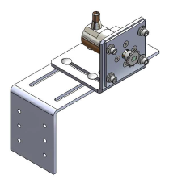
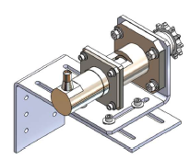
Current External Sensors
Platform | Details
CAN Encoder | On high precision (HP) drill systems we use a CAN encoder to provide depth information, if a PLC interface is not available. The encoder is mounted to either the drill head drive system by chain drive, torque reel cable or a flexible coupling. The encoder has one M12 connector that connects it to the CAN bus of the control module (Core or UHP hub) and uses the CANopen type of interface. It has one multicolor LED that indicates the state of the encoder to aid in fault finding. It has a 9mm shaft that can have a sprocket, high load bearing adapter, pulley or flexible coupling installed on it. There are a number of different mounting options available depending on the type of machine it is being installed on. The required mounting hardware is supplied with the system installation kit.

Slide 27
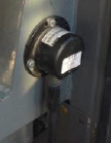
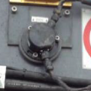
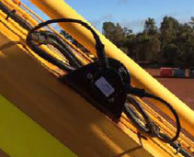
Current External Sensors
Platform | Details
Angle Sensor | On HP systems we use angle sensors to provide the pitch and roll of the machine, mast angle, and boom , stick and bucket angles. These sensors come in a single connector (chassis a bucket) and two connector (pass thru for mast angle, boom and stick) configuration and connect to the CAN bus of the control module (Core or UHP hub) and use the CANopen type of interface. The connector is a 4 pin military spec connector. The angle sensors are mounted to supplied mounting brackets along the long axis of the machine. They can be mounted facing either left or right. The sensors come configured with a specific ID so that each sensor on the CAN bus can be identified by the software. The sensors are fully sealed and are not repairable.

Slide 28
Current External Sensors
Platform | Details
Pressure Sensor | On HP drill systems we can use pressure sensors to provide operating pressures to enable the system to provide hardness information. Typically, three pressure sensors are installed to provide pulldown, rotation and bit air pressure. These sensors provide an analogue signal to indicate pressure.

Slide 29
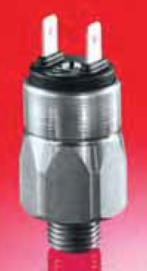
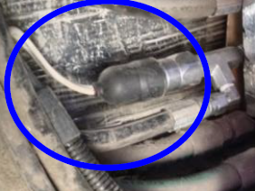
Current External Sensors
Platform | Details
Air Switch | On HP drill systems we can use an air switch to provide automated indication that the machine is drilling. We use a normally open switch with spade terminals and a rubber boot. The switch is preset to a specific pressure but can be adjusted via a small screw located between the terminals. Typically the switch is connected, via a T piece to the air line that feeds the bit air pressure gauge.

Slide 30
Antennas

Slide 31
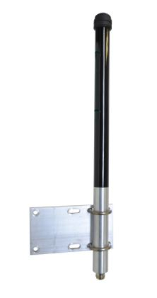
Antennas
Platform | Details
Mobilemark Wi-Fi Antenna | The standard antenna we supply for Wi-Fi communications is heavy duty 6db gain omni directional 2.4Ghz antenna manufactured by Mobilemark. It has a foam filled core to make it vibration resistant and comes with a N female connection. The antenna is supplied with an aluminum bracket and U bolts for mounting to handrails and mirror supports. Typically we install two antennas on most equipment for diversity to ensure the best possible communications on the mobile equipment. As a standard we use LMR400 cable to connect the antenna to the hub to ensure minimal signal loss.

Slide 32
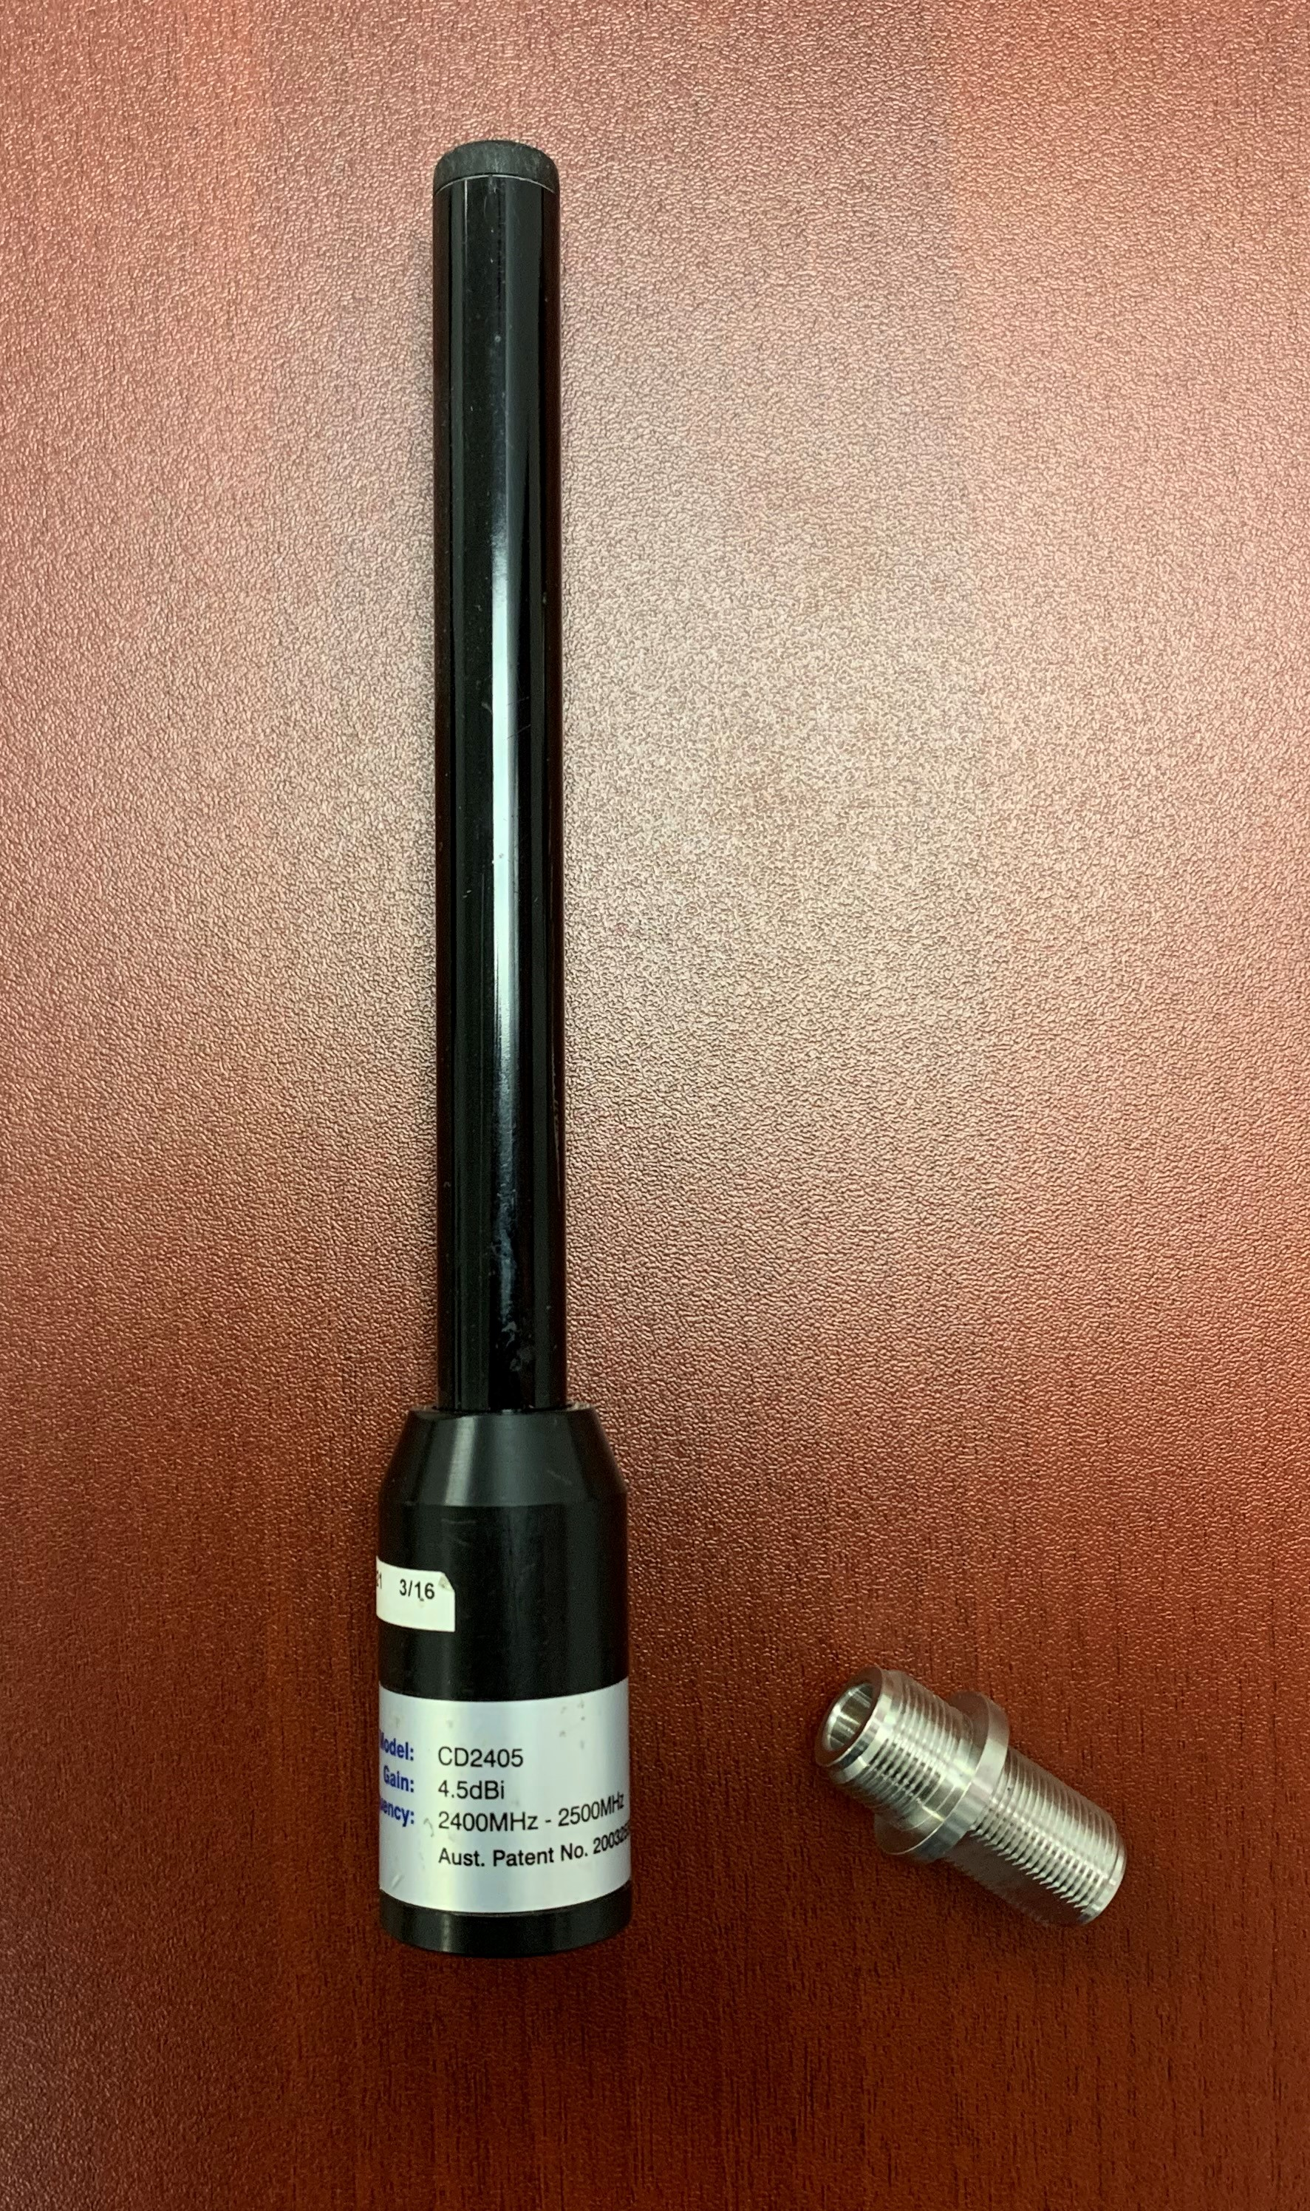
Antennas
Platform | Details
RFI Wi-Fi Antenna | For systems were a Jasset was installed we used either the standard mobile mark antenna or in some instances we used a smaller 4.5db gain omni directional 2.4Ghz antenna manufactured by RFI. This antenna requires a separate mounting bracket that was supplied with the Jasset systems and has N male connection requiring an N female to N female adapter to be used, this is also supplied with the Jasset system.

Slide 33
Antennas
Platform | Details
G3 GNSS Antenna | Our standard GNSS antenna for all LP systems is the G3 antenna from Antcom. The G3 is a 33db gain antenna that will track satellites in the L1 GPS and L1 Glonass bands. It has an incorporate ground plane and TNC female connector with a nominal supply voltage of 5V DC. The G3 has an industry standard 5/8” threaded socket allowing it to be easily mounted to our standard mounting brackets. These antenna are very robust, with a low failure rate.

Slide 34
Antennas
Platform | Details
G5 GNSS Antenna | Our standard GNSS antenna for all HP systems is the G5 antenna from Antcom. The G5 is a 35db gain antenna that will track satellites in the L1 & L2 GPS and L1 & L2 Glonass bands. It has an incorporate ground plane and TNC female connector with a nominal supply voltage of 5V DC. The G5 has an industry standard 5/8” threaded socket allowing it to be easily mounted to our standard mounting brackets. These antenna are very robust, with a low failure rate. As you can see the G5 looks identical to the G3 the only way to correctly identify them is by reading the identification label on the underside of the ground plane.

Slide 35
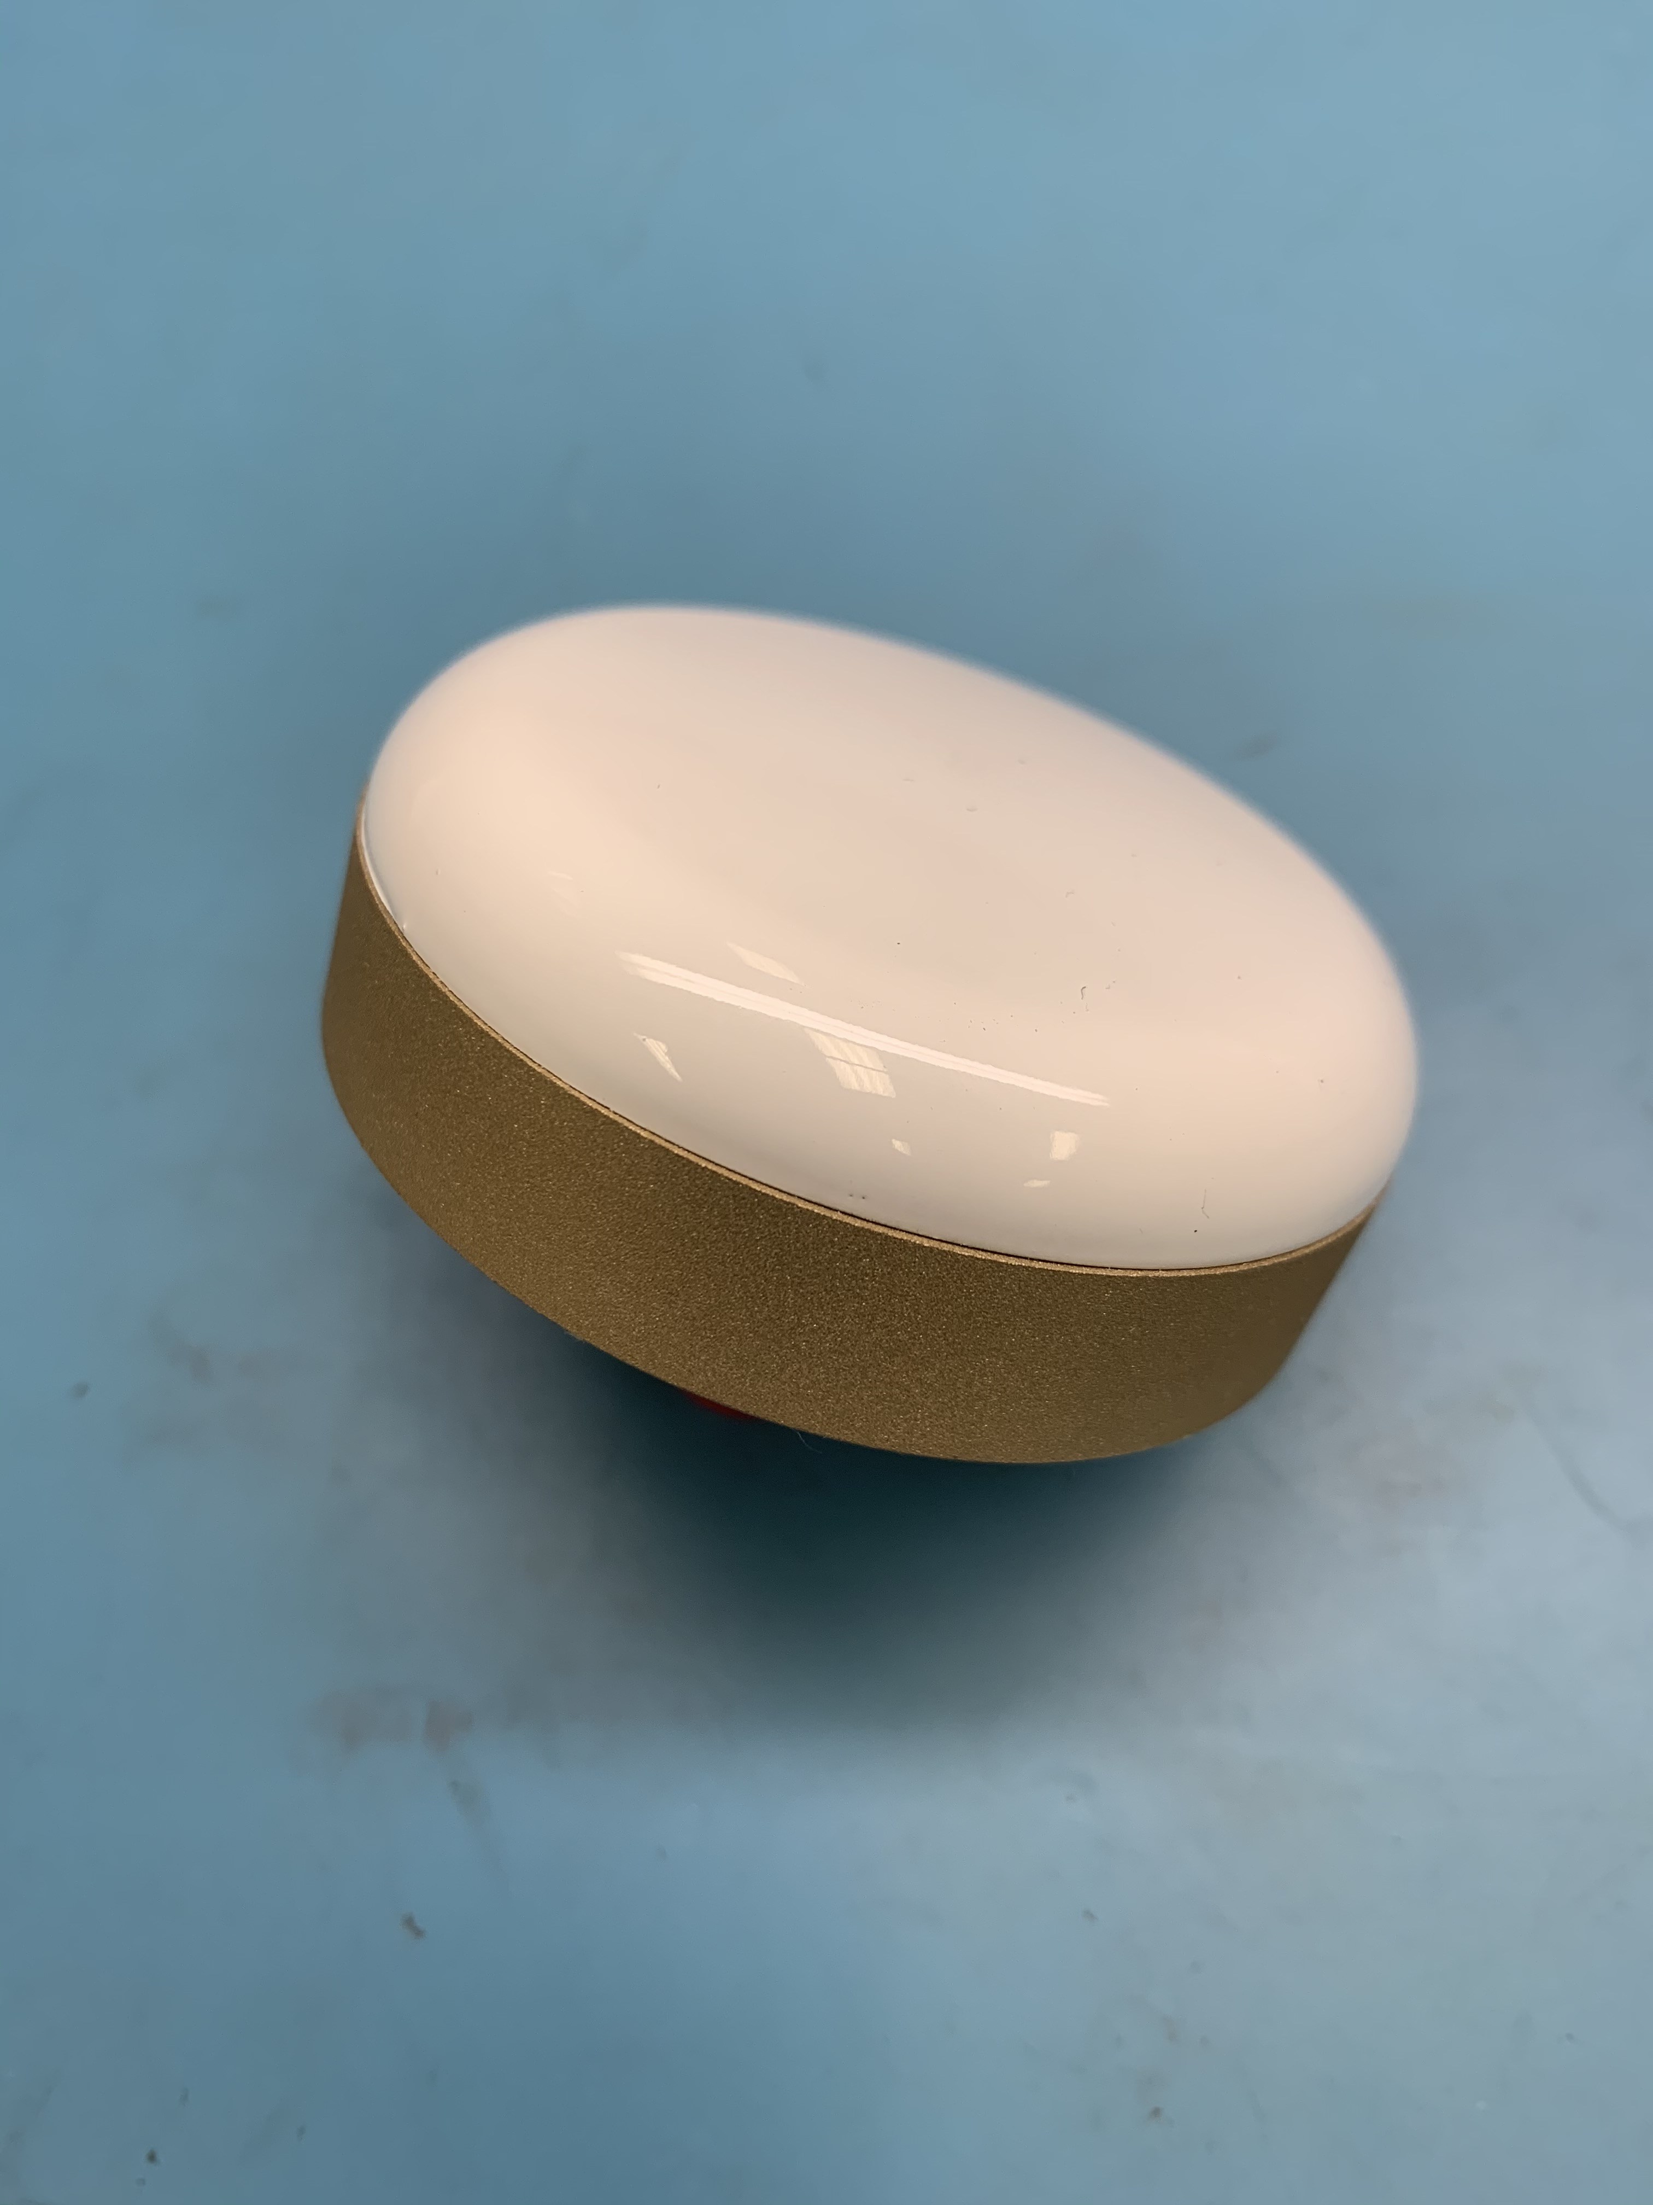
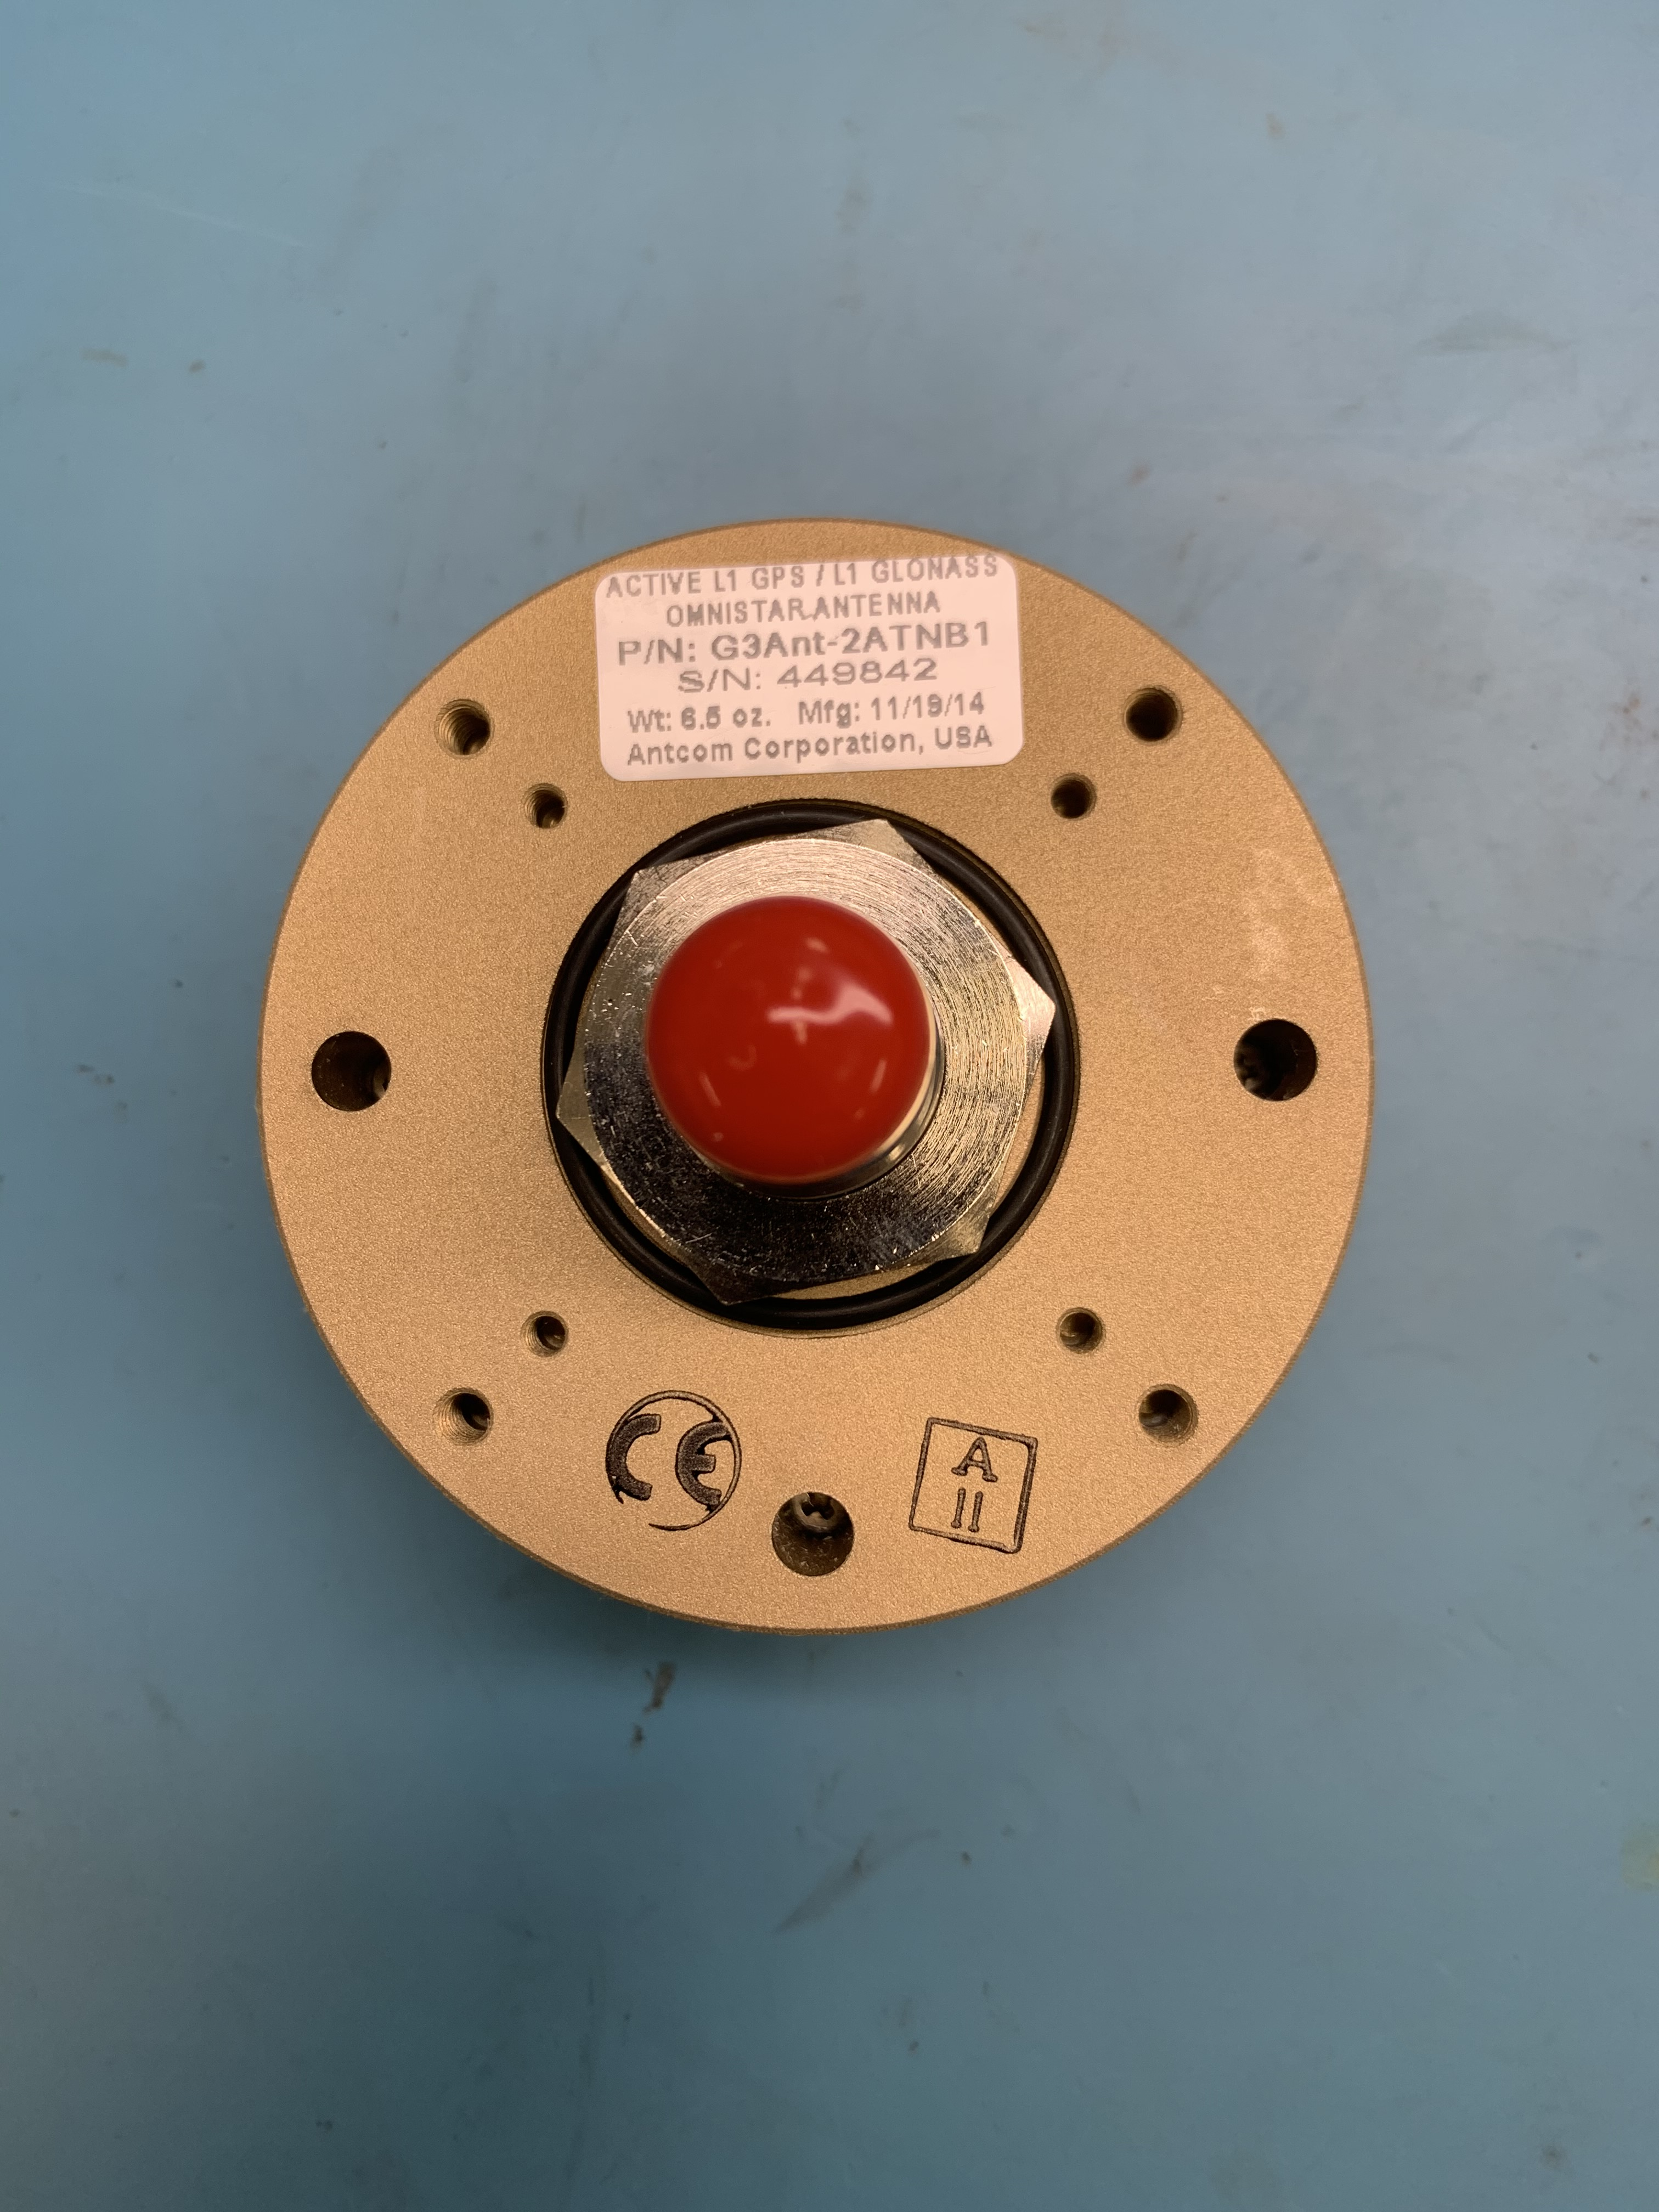
Antennas
Platform | Details
Mini G3 GNSS Antenna | For mobile systems using the Jasset module we use the Mini G3 antenna. This antenna has the same specs as the G3 antenna but does not have an incorporated ground plane. It has a center post with a 16mm thread for mounting and a TNC connector.

Slide 36
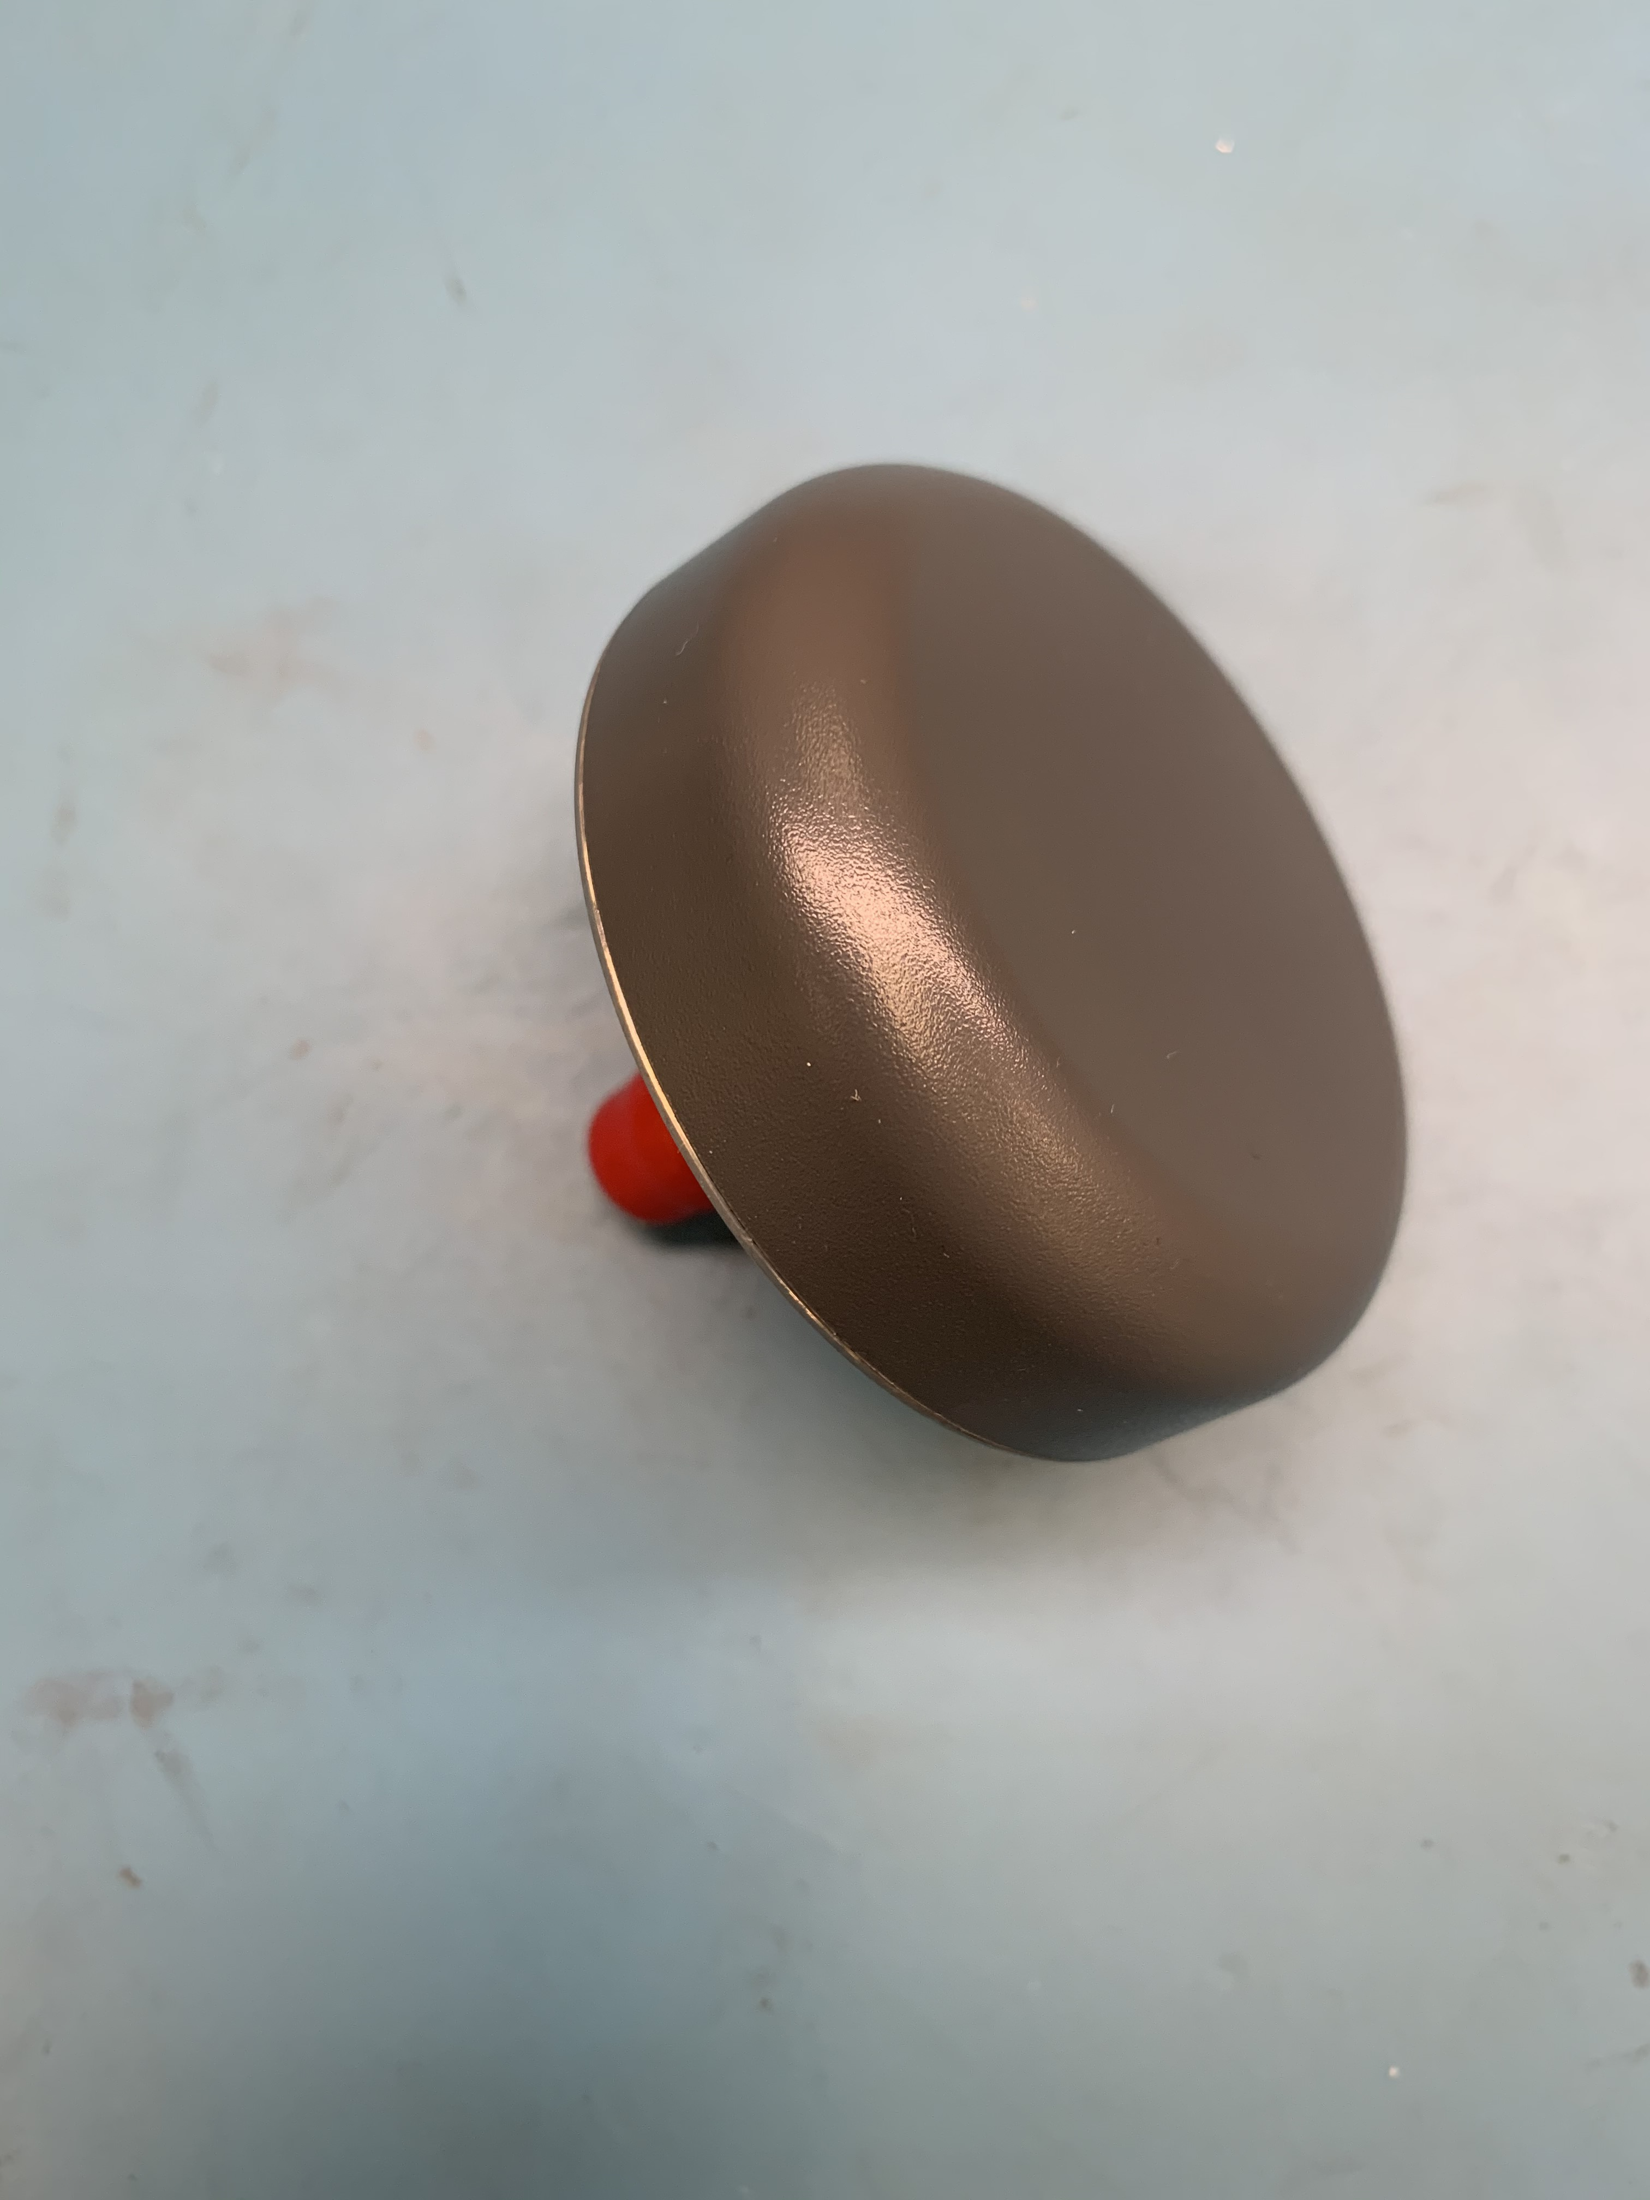
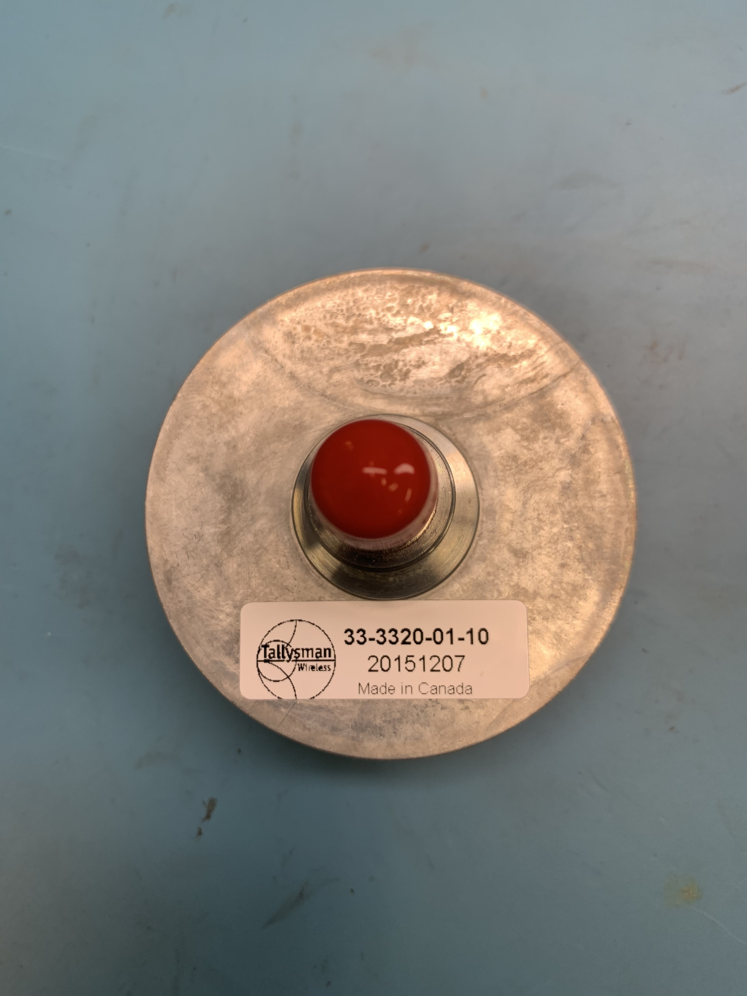
Antennas
Platform | Details
Tallysman GNSS Antenna | For fixed systems using the Jasset module we use the Tallysman antenna. This antenna has a low gain than the Mini G3 and a lower cost making it preferable for systems when the equipment rarely moves or only moves at slow speeds. It has a center post with a 16mm thread for mounting and a TNC connector.

Slide 37
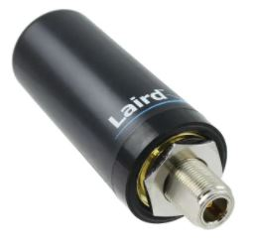
Antennas
Platform | Details
Cellular Antenna | For cellular communications we use a Laird TRA6927M3PB-001 4G antenna. This is a 5.5db gain omni direction antenna that covers the 829Mhz to 2.2Ghz frequency range. It has an N female connector and mounts to standard brackets with a 16mm hole.

Slide 38
Current External Sensors and Questions
True or False On high precision (HP) drill systems we use a pressure sensors to provide depth information.
True or False On HP systems we use angle sensors to provide the pitch and roll of the machine.
What are the external sensors usually installed in HP shovel?
Boom angle
Stick angle
Air switch
Bucket angle
All above
True or False The standard antenna we supply for Wi-Fi communications is manufactured by RFI.
True or False Our standard GNSS antenna for all HP systems is the G3 antenna from Antcom.

Slide 39
Current External Sensors and Antennas - Questions
True or False On high precision (HP) drill systems we use a pressure sensors to provide depth information. False
True or False On HP systems we use angle sensors to provide the pitch and roll of the machine. True
What are the external sensors usually installed in HP shovel?
Boom angle
Stick angle
Air switch
Bucket angle
All above
True or False The standard antenna we supply for Wi-Fi communications is manufactured by RFI. False
True or False Our standard GNSS antenna for all HP systems is the G3 antenna from Antcom. False

Slide 40
Example System Configurations

Slide 41
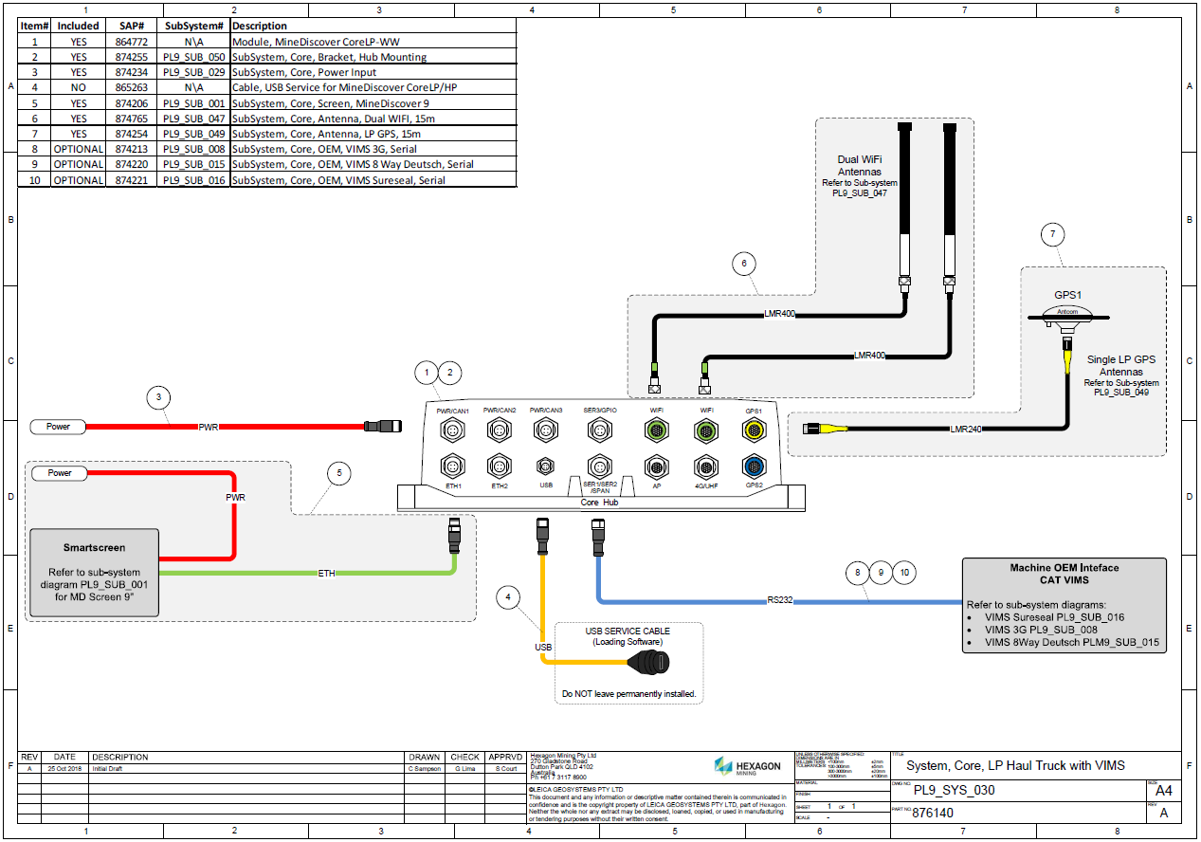
Example System Configurations
LP Truck Core HW

Slide 42
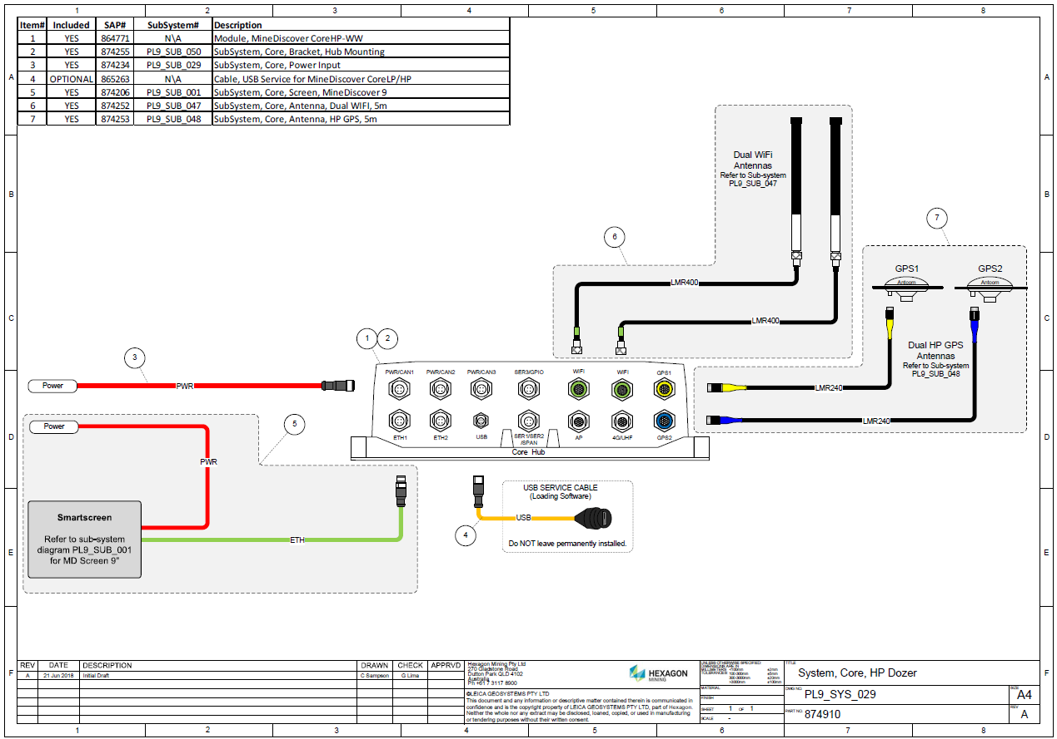
Example System Configurations
HP Dozer Core HW

Slide 43
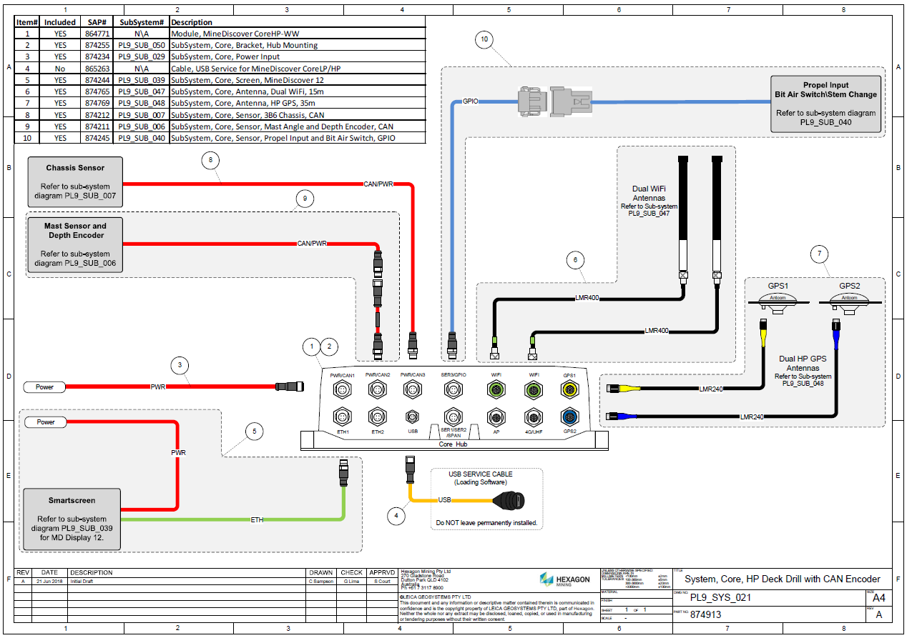
Example System Configurations
HP Drill Core HW

Slide 44
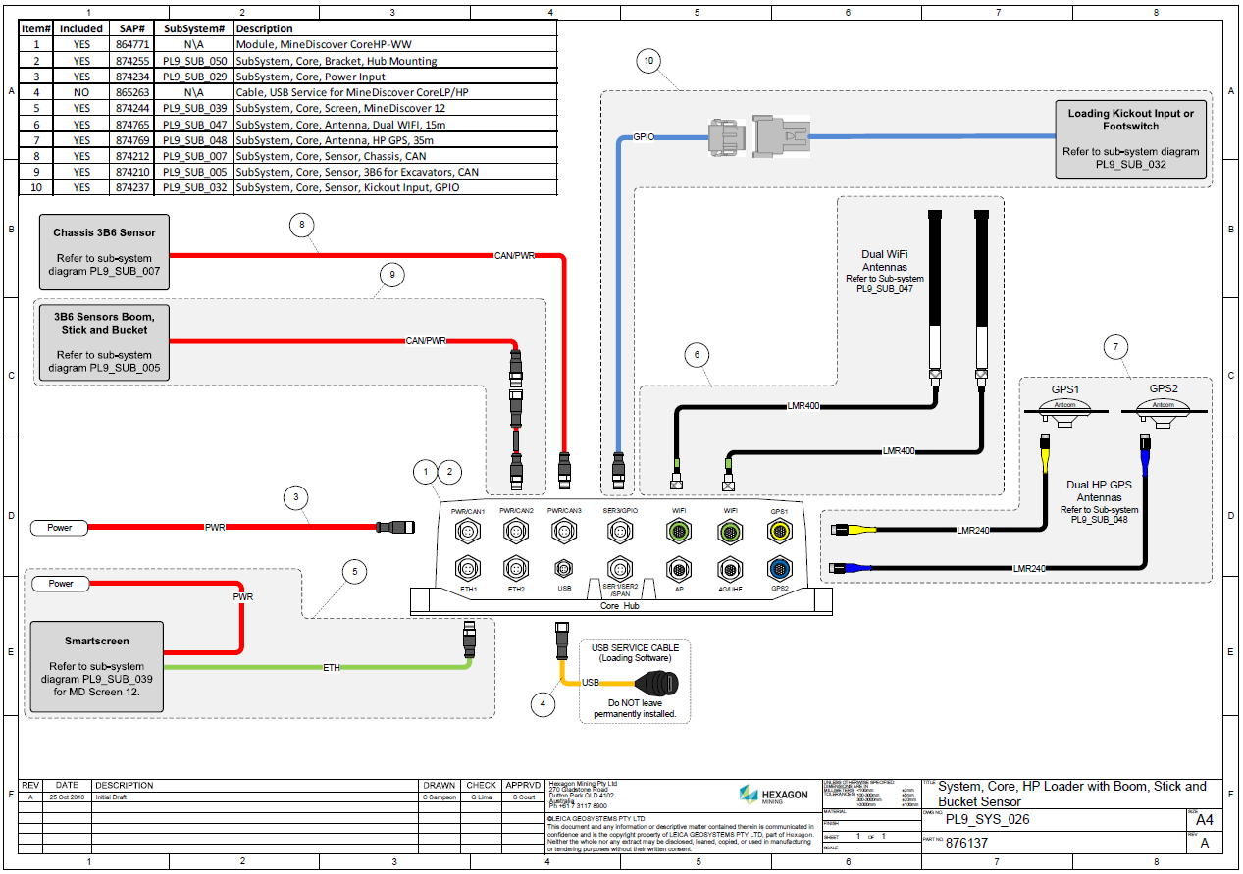
Example System Configurations
HP Shovel / Excavator Core HW

Slide 45
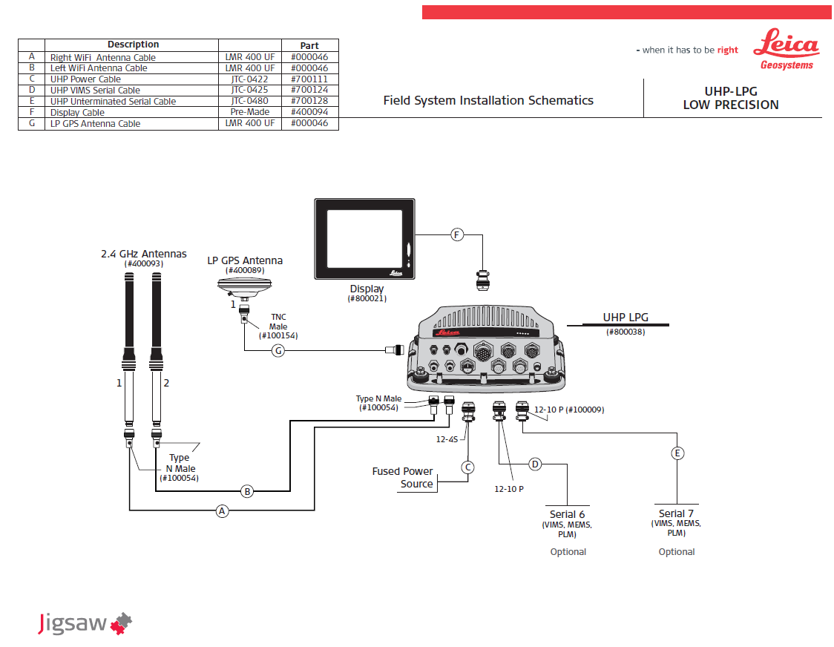
Example System Configurations
LP Truck UHP HW

Slide 46
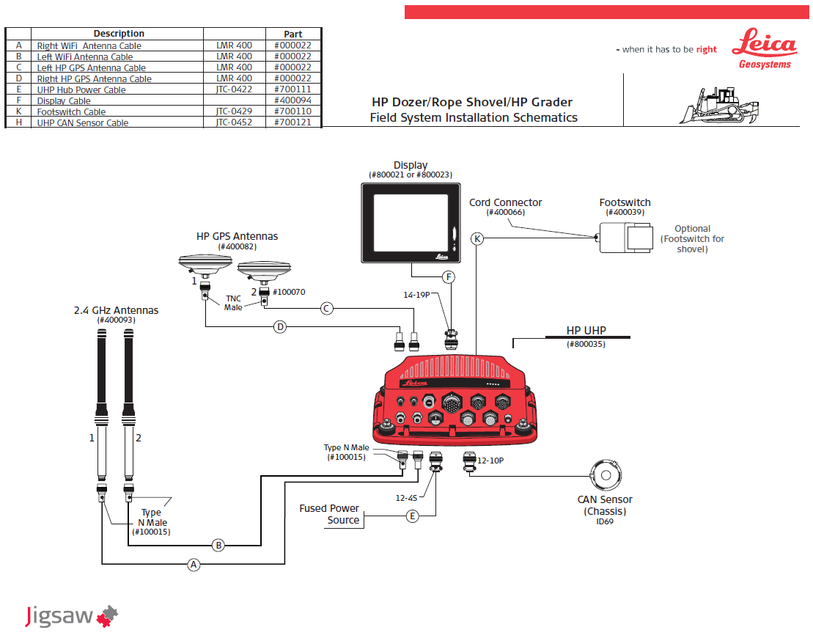
Example System Configurations
HP Dozer UHP HW

Slide 47
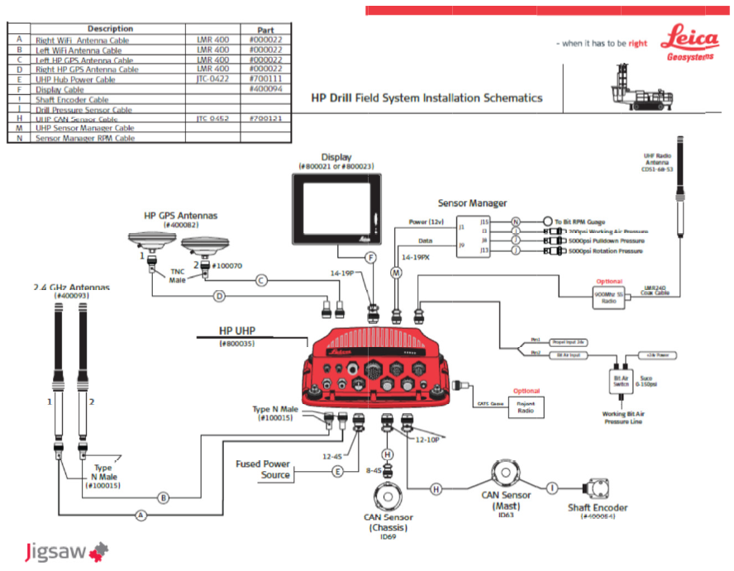
Example System Configurations
HP Drill UHP HW

Slide 48
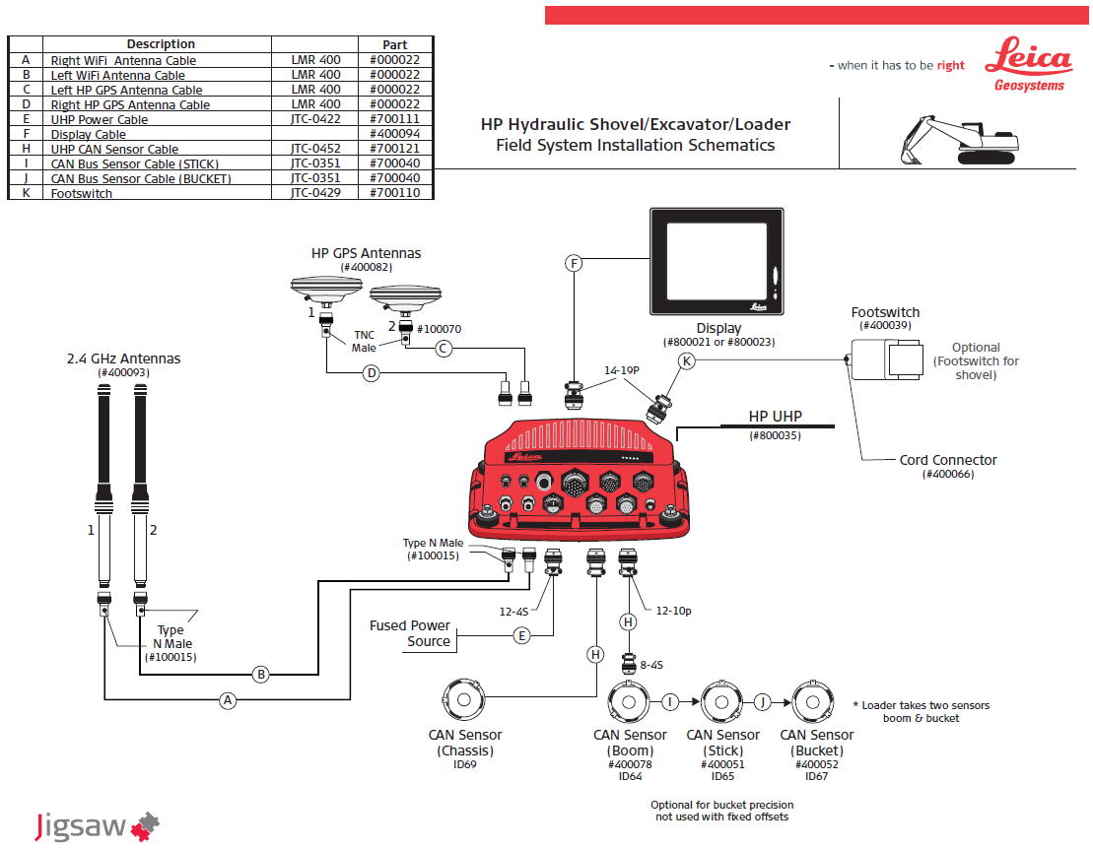
Example System Configurations
HP Shovel / Excavator UHP HW

Slide 49
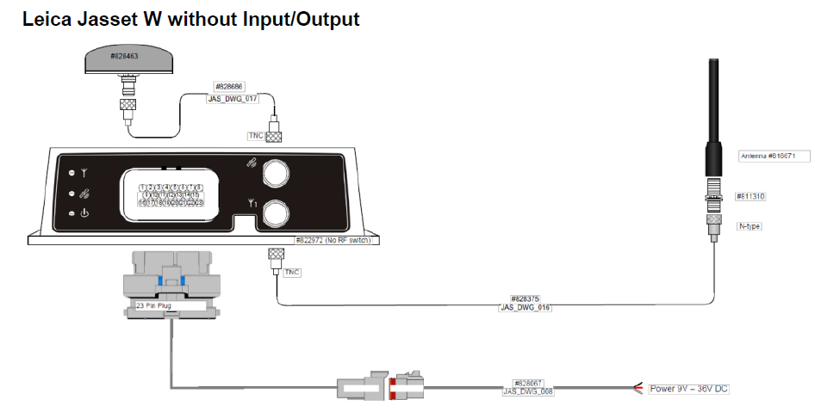
Example System Configurations
Jasset Systems

Slide 50
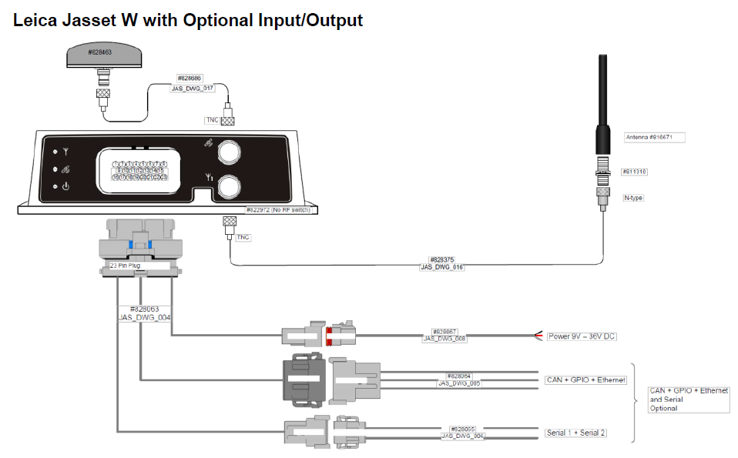
Example System Configurations
Jasset Systems

Slide 51
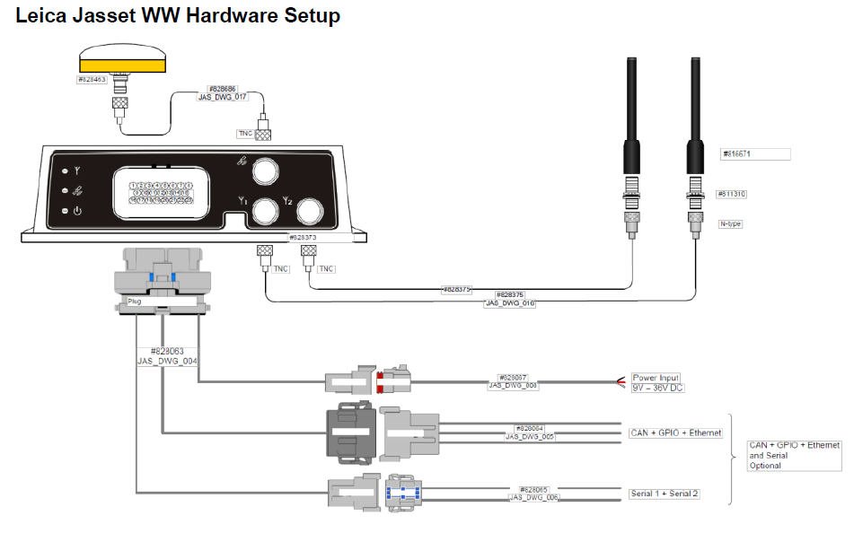
Example System Configurations
Jasset Systems

Slide 52
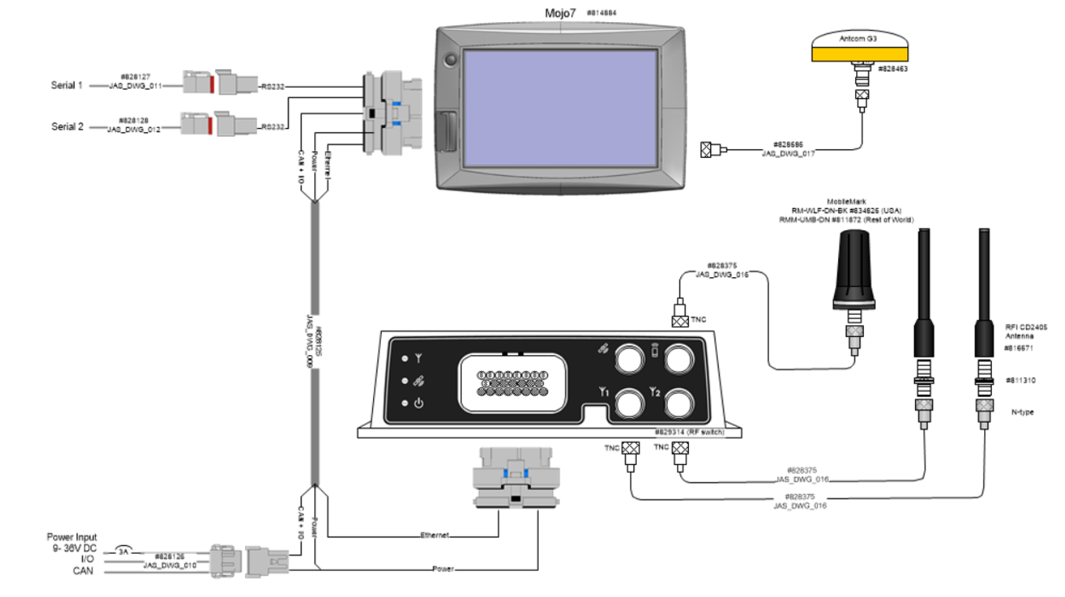
Example System Configurations
Mojo7

Slide 53
Installation Hardware

Slide 54
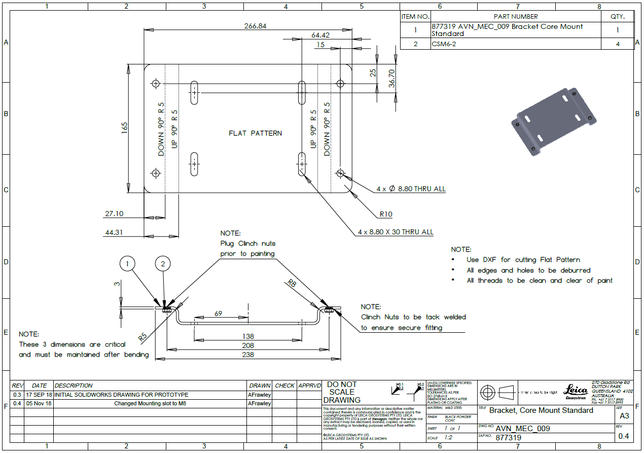
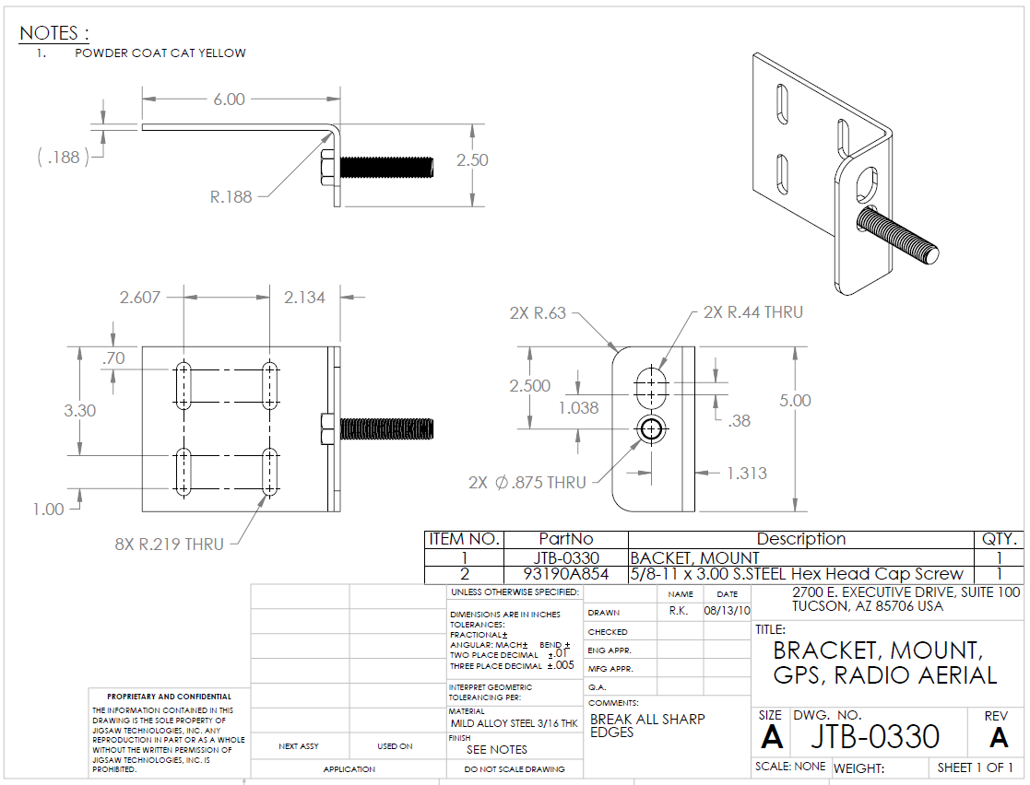
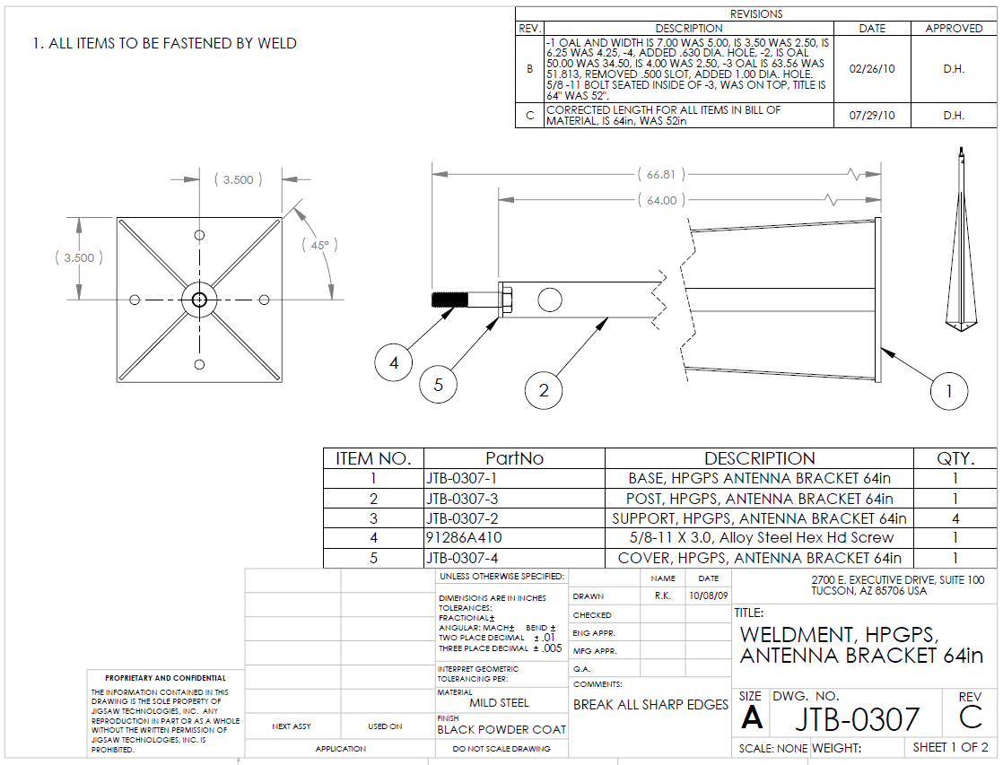
Installation Hardware
Install Kits
There are standard install kits for each hardware configuration that include brackets and mounting hardware (nuts, bolts and screws) for mounting the hub, screen and sensors. Cable and connectors for assembling antenna cables, fuse holders, fuses and crimp connectors for power connections, electrical and splicing tape and conduit and fittings for routing cables into or out of the cab of the machine.
These are supplied as part of each system and differ slightly depending on the type of system being installed.
In the majority of cases no extra hardware is required but installers should always carry spare connectors, crimps, nut bolts and screws to account for unforeseen circumstances.
Prior to any installation a pre install inspection should be done to identify if special brackets or and any extra items are required.

Slide 55
System Configurations - Questions
What is the default serial port configured when you directly connect to Core S1/S2 port? ____
True or False P6 is the standard can port to install Chassis sensor in UHP.
True or False Mast sensor standard installation is in CAN2 port in UHP hardware.
What are ID configurations for external angle sensors?
63
64
69
401
All above
True or False All install kits are supplied as part of each system and differ slightly depending on the type of system being installed.

Slide 56
System Configurations - Answers to Questions
What is the default serial port configured when you directly connect to Core S1/S2 port? S1
True or False P6 is the standard can port to install Chassis sensor in UHP. True
True or False Mast sensor standard installation is in CAN2 port in UHP hardware. True
What are ID configurations for external angle sensors?
63
64
69
401
All above
True or False All install kits are supplied as part of each system and differ slightly depending on the type of system being installed. True

Slide 57

THANK
Y
O
U

